Slide 1


Noida Institute of Engineering and Technology, Greater Noida
Python Web Development with Django
Unit: IV
Connecting SQLite with Django
Priya Singh
(Asst. Professor)
CSE Department
Course Details (B. Tech. 5th Sem)

Slide 2

Faculty Introduction
Name | Priya Singh
Qualification | M. Tech. (Computer Engineering)
Designation | Assistant Professor
Department | Computer Science & Engineering
Total Experience | 3 years
NIET Experience | 1 years
Subject Taught | Design & Analysis of Algorithm, Data Structures, Artificial Intelligence, Soft Computing, C Programming, Web Technology, Discrete Mathematics.

Slide 3
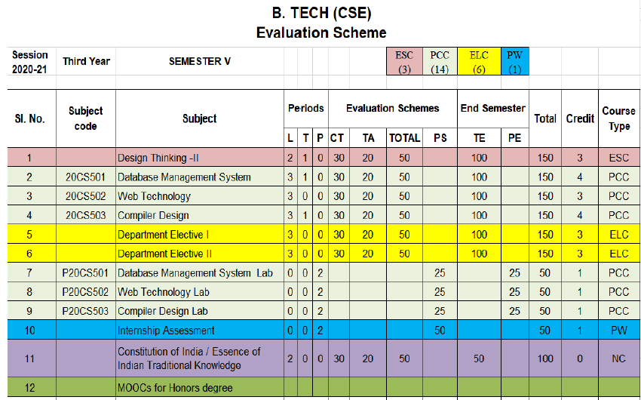
Evaluation Scheme
Python Web development with Django (Elective I)
Design Pattern (Elective II)

Slide 4
Syllabus
UNIT-I: Python libraries for web development
Collections-Container datatypes, Tkinter-GUI applications, Requests-HTTP requests, BeautifulSoup4-web scraping, Scrapy, Zappa, Dash, CherryPy, TurboGears, Flask, Web2Py,
Bottle, Falcon, CubicWeb, Quixote, Pyramid.

Slide 5
Syllabus
UNIT-II: Introduction to Django Framework
Understanding Django environment, Features of Django and Django architecture, MVC &MTV, Urls and Views, Mapping the views to URLs, Django Template, Template inheritance Django Models, Creating model for site, Converting the model into a table, Fields in Models, Integrating Bootstrap into Django, Creating tables, Creating grids, Creating carousels.

Slide 6
Syllabus
UNIT-III: Integrating Accounts & Authentication on Django
Introduction to Django Authentication System, Security Problem & Solution with Django Creating Registration Form using Django, Adding Email Field In Forms, Configuring email settings, Sending emails with Django, Adding Grid Layout On Registration Page, Adding Page Restrictions, Login Functionality Test and Logout.

Slide 7
Syllabus
UNIT-IV: Connecting SQLite with Django
Database Migrations, Fetch Data From Database, Displaying Data On Templates, Adding Condition On Data, Sending data from url to view, Sending data from view to template, Saving objects into database, Sorting objects, Filtering objects, Deleting objects, Difference between session and cookie, Creating sessions and cookies in Django.

Slide 8
Syllabus
UNIT-V: Deploying Django Web Application on Cloud
Creating a functional website in Django, Four Important Pillars to Deploy, Registering on Heroku and GitHub, Push project from Local System to GitHub, Working with Django Heroku
Working with Static Root, Handling WSGI with gunicorn, Setting up Database & adding users

Slide 9
Branch Wise Application
1. Real time web analytics
2. Digital Advertising
3. E-Commerce
4. Publishing
5. Massively Multiplayer Online Games
6. Backend Services and Messaging
7. Project Management & Collaboration
8. Real time Monitoring Services
9.Live Charting and Graphing
10. Group and Private Chat

Slide 10
Course Objective
In this semester, the students will
Study how to shows relationships and interactions between frontend &backend
Study to speed up the development process by providing well-tested, proven development/design paradigms.
Select a specific framework for the development of a given website or webapp.
Analyzing and creating a functional website in Django and deploy Django Web Application on Cloud.

Slide 11
Course Outcomes (COs)
At the end of course, the student will be able to:
CO1 : Apply the knowledge of python programing that are vital in understanding Django application
CO2 : Demonstrate web application framework (Django) to design and implement dynamic website
CO3 : Implementing and analyzing the concept of Integrating Accounts & Authentication on Django
CO4 : Understand the impact of web designing by database connectivity with SQLite
CO5 : Analyzing & Creating a functional website in Django and deploy Django Web Application Cloud

Slide 12
Program Outcomes (POs)
Engineering Graduates will be able to:
PO1 : Engineering Knowledge
PO2 : Problem Analysis
PO3 : Design/Development of solutions
PO4 : Conduct Investigations of complex problems
PO5 : Modern tool usage
PO6 : The engineer and society

Slide 13
Program Outcomes (POs)
Engineering Graduates will be able to:
PO7 : Environment and sustainability
PO8 : Ethics
PO9 : Individual and teamwork
PO10 : Communication
PO11 : Project management and finance
PO12 : Life-long learning

Slide 14

COs - POs Mapping
CO.K | PO1 | PO2 | PO3 | PO4 | PO5 | PO6 | PO7 | PO8 | PO9 | PO10 | PO11 | PO12
CO1 | 2 | 2 | 2 | 3 | 3 | - | - | - | - | - | - | -
CO2 | 3 | 2 | 3 | 2 | 3 | - | - | - | - | - | - | -
CO3 | 3 | 2 | 3 | 2 | 3 | - | - | - | - | - | - | -
CO4 | 3 | 2 | 3 | 2 | 3 | - | - | - | - | - | - | -
CO5 | 3 | 2 | 3 | 3 | 3 | - | - | - | - | - | - | -
AVG | 2.8 | 2.0 | 2.8 | 2.4 | 3.0 | - | - | - | - | - | - | -

Slide 15
Program Specific Outcomes(PSOs)
S. No. | Program Specific Outcomes (PSO) | PSO Description
1 | PSO1 | Understand to shows relationships and interactions between classes or objects of a pattern.
2 | PSO2 | Study to speed up the development process by providing well-tested, proven development
3 | PSO3 | Select a specific design pattern for the solution of a given design problem
4 | PSO4 | Create a catalogue entry for a simple design pattern whose purpose and application is understood.

Slide 16
COs - PSOs Mapping
CO.K | PSO1 | PSO2 | PSO3 | PSO4
CO1 | 3 | - | - | -
CO2 | 3 | 3 | - | -
CO3 | 3 | 3 | - | -
CO4 | 3 | 3 | - | -
CO5 | 3 | 3 | - | -

Slide 17
Program Educational Objectives (PEOs)
Program Educational Objectives (PEOs) | PEOs Description
PEOs | To have an excellent scientific and engineering breadth so as to comprehend, analyze, design and provide sustainable solutions for real-life problems using state-of-the-art technologies.
PEOs | To have a successful career in industries, to pursue higher studies or to support entrepreneurial endeavors and to face the global challenges.
PEOs | To have an effective communication skills, professional attitude, ethical values and a desire to learn specific knowledge in emerging trends, technologies for research, innovation and product development and contribution to society.
PEOs | To have life-long learning for up-skilling and re-skilling for successful professional career as engineer, scientist, entrepreneur and bureaucrat for betterment of society.

Slide 18
Result Analysis(Department Result & Subject Result & Individual result
Name of the faculty | Subject code | Result % of clear passed

Slide 19
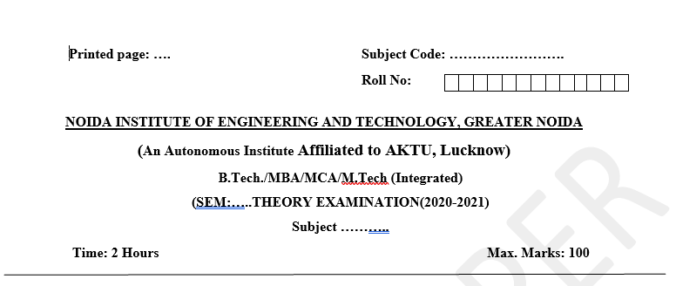
Pattern of Online External Exam Question Paper (100 marks)

Slide 20
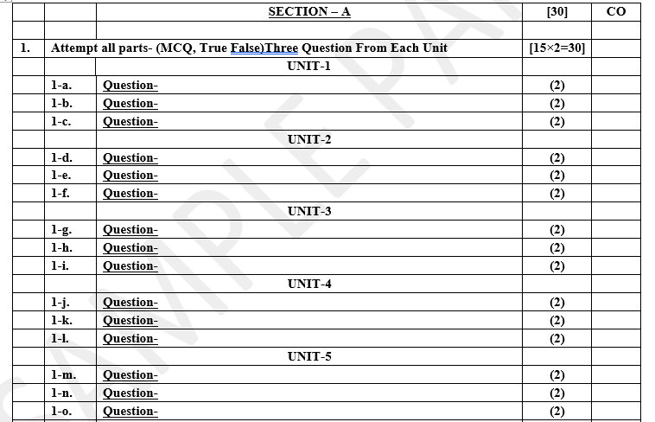
Pattern of Online External Exam Question Paper (100 marks)

Slide 21
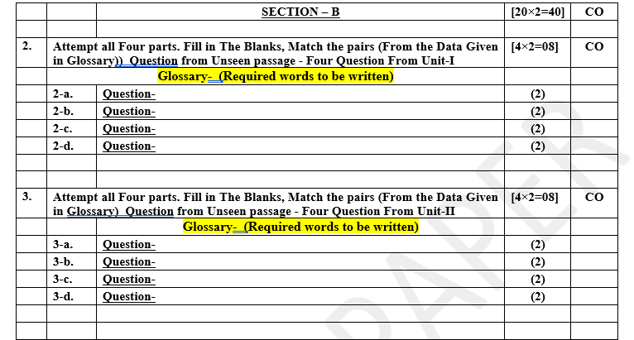
Pattern of Online External Exam Question Paper (100 marks)

Slide 22
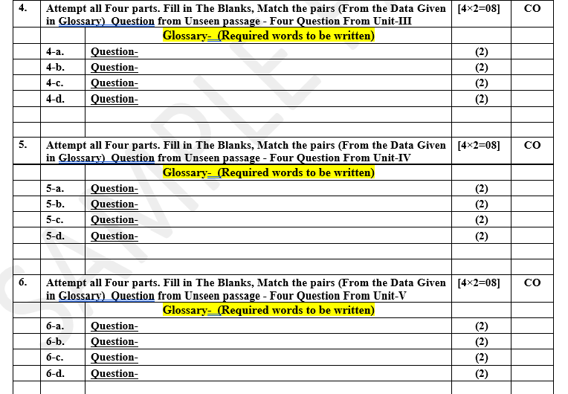
Pattern of Online External Exam Question Paper (100 marks)

Slide 23
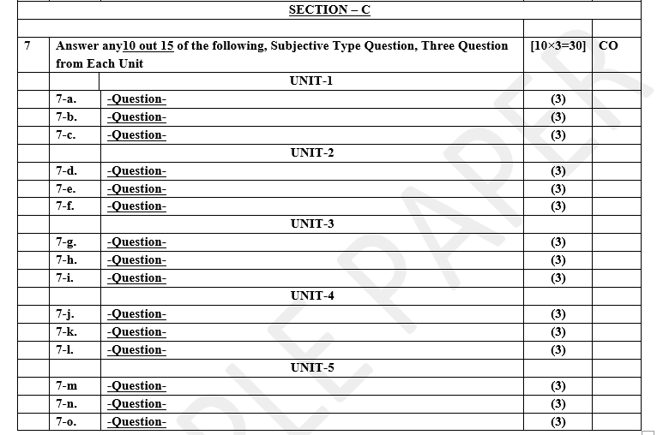
Pattern of Online External Exam Question Paper (100 marks)

Slide 24
Prerequisite / Recap
Student should have knowledge of HTML , CSS and JavaScript .
Students should have good knowledge of Python Programming and Python coding experience.
knowledge of Computer and basic skill.
Good problem solving Skill .

Slide 25
Brief Introduction about the Subject with videos
YouTube /other Video Links
https://youtu.be/eoPsX7MKfe8?list=PLIdgECt554OVFKXRpo_kuI0XpUQKk0ycO
https://youtu.be/tA42nHmmEKw?list=PLh2mXjKcTPSACrQxPM2_1Ojus5HX88ht7
https://youtu.be/8ndsDXohLMQ?list=PLDsnL5pk7-N_9oy2RN4A65Z-PEnvtc7rf
https://youtu.be/QXeEoD0pB3E?list=PLsyeobzWxl7poL9JTVyndKe62ieoN-MZ3
https://youtu.be/9MmC_uGjBsM?list=PL3pGy4HtqwD02GVgM96-V0sq4_DSinqvf

Slide 26
Unit IV Content
Database Migrations.
Fetch Data From Database.
Displaying Data On Templates.
Adding Condition On Data.
Sending data from url to view.
Sending data from view to template.
Saving objects into database, Sorting objects, Filtering objects, Deleting objects.
Difference between session and cookie, Creating sessions and cookies in Django.

Slide 27
Unit IV Objective
In Unit IV, the students will be able to find
Definitions of terms Database Migrations.
How Fetch Data From Database & Displaying Data On Templates.
How to Send data from url to view.
How to Send data from view to template.
The idea of a python Library .
Difference between session and cookie, Creating sessions and cookies in Django

Slide 28
Topic Objective
Topic : Database Migrations
In this topic, the students will gain , The idea of Database migration is the process of migrating data from one or more source databases to one or more target databases by using a database migration service.

Slide 29
Database Migrations
Database migration: Concepts and principles
Database migration is the process of migrating data from one or more source databases to one or more target databases by using a database migration service.
When a migration is finished, the dataset in the source databases resides fully, though possibly restructured, in the target databases. Clients that accessed the source databases are then switched over to the target databases, and the source databases are turned down.
A database migration service runs within Google Cloud and accesses both source and target databases. Two variants are represented: (a) shows the migration from a source database in an on-premises data center or a remote cloud to a managed database like Cloud Spanner; (b) shows a migration to a database on Compute Engine

Slide 30
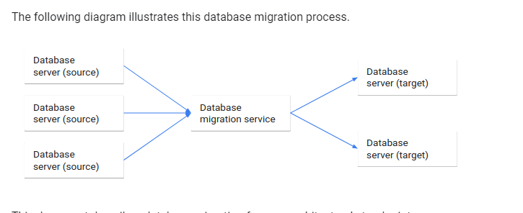
Database Migrations
Database Migration Process

Slide 31
Database Migrations
We describe Database migration from an architectural stand pointwise:-
The services and technologies involved in database migration.
The differences between homogeneous and heterogeneous database migration.
The tradeoffs and selection of a migration downtime tolerance.
A setup architecture that supports a fallback if unforeseen errors occur during a migration.
This document does not describe how you set up a particular database migration technology. Rather, it introduces database migration in fundamental, conceptual, and principle terms.

Slide 32
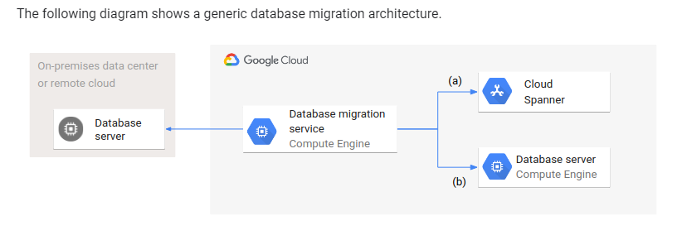
Database Migrations
Database Migration Architecture:-
Even though the target databases are different in type (managed and unmanaged) and setup, the database migration architecture and configuration is the same for both cases.

Slide 33
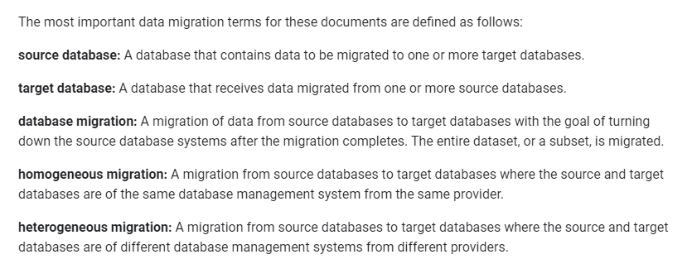
Database Migrations
Terminology :-

Slide 34
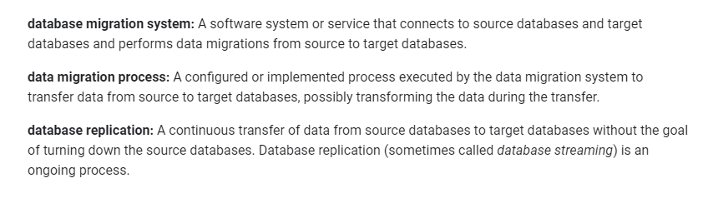
Database Migrations
Terminology :-

Slide 35
Database Migrations
Database migration architecture :-
A database migration architecture describes the various components required for executing a database migration. This section introduces a generic deployment architecture and treats the database migration system as a separate component. It also discusses the features of a database management system that support data migration as well as non-functional properties that are important for many use cases.
Deployment architecture:-
A database migration can occur between source and target databases located in any environment, like on-premises or different clouds. Each source and target database can be in a different environment; it is not necessary that all are collocated in the same environment.

Slide 36
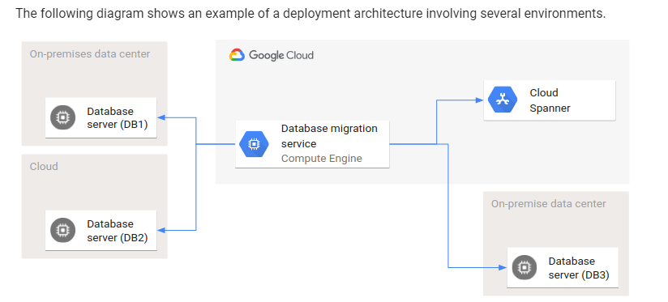
Database Migrations

Slide 37
Fetch Data From Database
How to fetch data from database in django?
In django, we retrieve the data in the views.py file, where we write our functions.
To retrieve data from database, first we have to create a url for that. Open the urls.py file inside the application folder, and create a new path as shown below:
path('students/', views.students, name="students"),
Now create a function in the views.py file, with the name "students" as shown in the above path.

Slide 38

Fetch Data From Database
Here, we have created a variable form and we have called all the objects of the Student model. Objects is nothing but the records in the database. Then we have created a dictionary named context and passed the form variable in the dictionary and passed that dictionary in the render() function.
As we have mentioned in the render(), let us create a .html file with the name index.html and we will be displaying the all the data in the index.html. To display the data, we will be using the for loop as there will be multiple data in our database.

Slide 39
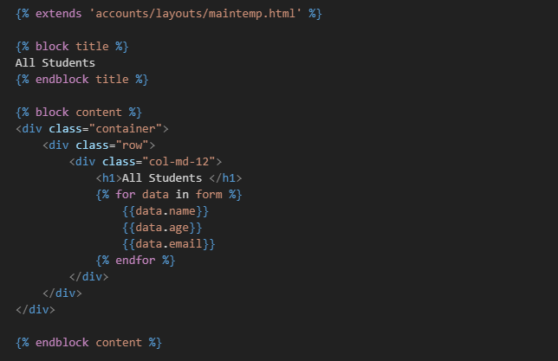
Fetch Data From Database
This will print all the data that we had fetched and stored in the form variable.

Slide 40
Displaying Data On Templates
Django templates
Sometimes you want parts of your website to display dynamic data - that is, data that might be different every time someone opens your website. In that case, plain HTML won't be enough.
Luckily, Django templates allow us to do a lot more than just write HTML. We can display some Python variables that we defined in our view. Django also gives us some helpful built-in template tags for displaying data.
Django template tags allow us to transfer Python-like things into HTML, so you can build dynamic websites faster and easier

Slide 41
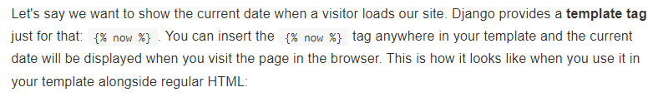
Displaying Data On Templates
Display the current date and time:

Slide 42
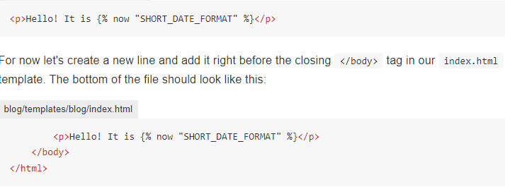
Displaying Data On Templates

Slide 43
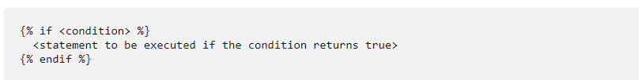
Adding Condition On Data
The if template tag is one of the template tags in Django that can be used to render HTML content for a particular condition. Let us see how to use the if template tag in Django.
In a Django template, the if statement is referred to as if tag. You can use this if tag to render HTML content based on a particular condition. The syntax of the if template tag is:

Slide 44
Adding Condition On Data
In a Django template, you have to close the if template tag. You can write the condition in an if template tag. Inside the block, you can write the statements or the HTML code that you want to render if the condition returns a True value.
Now let us see an example of the if tag.
I have created an example where I will enter two numbers and compare them inside a Django template.
The following is the Django template where I will submit the two numbers:

Slide 45
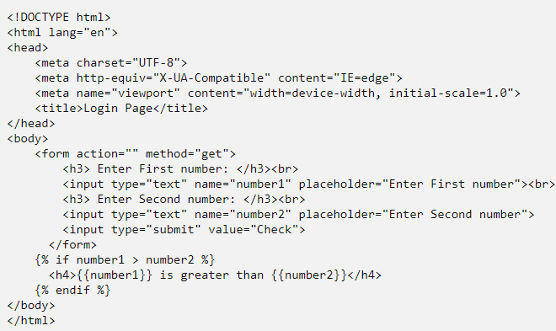
Adding Condition On Data

Slide 46
Sending data from url to view
Get URL parameters in Django
In Django, you can also pass parameters as part of the URL. In this Django tutorial, you will learn how to get URL parameters in Django.
In various web applications, you might have seen some URLs that end with some parameters. For example, look at the below URL:
https://www.shop.tsinfo.com/products/12
The above URL fetches the products page corresponding to a product id i.e. 12. This means 12 is a URL parameter and the result is shown according to this value.

Slide 47
Sending data from url to view
To get a parameter from the URL, you have to perform the steps explained below:
Create and map a path to a view in the application’s URLs file and pass the parameters to the view
Define a function in the view that will take the parameter and pass the parameters to Django template.
Design the Django template to show the results corresponding the passed parameters.
Let us discuss these steps briefly in the upcoming sections.

Slide 48
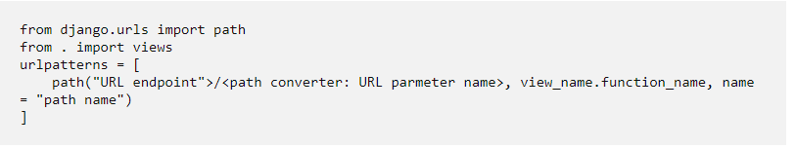
Sending data from url to view
Django URL pass parameter to view
You can pass a URL parameter from the URL to a view using a path converter.
But, firstly you have to create a path and map it to a view.
For this, you have to edit your application’s urls.py file.
A sample urls.py file will look like this:

Slide 49
Sending data from url to view
For example, if the requested URL is:
https://www.shop.tsinfo.com/products/12
Then “products” will be the URL endpoint.
A path converter defines which type of data will a parameter store. You can compare path converters with data types. In the above example, the path converter will be int.
You will learn more about various path converters in the upcoming sections.
URL parameter name will be the name that you will use to refer to the parameter.
The view_name will be the view that will handle the request and the function_name is the function that will be executed when the request is made to the specified URL endpoint.
The name will be the name of the path that you are going to create.

Slide 50
Sending data from view to template
We will talk about passing dynamic data to templates for rendering it.
As we know django is a MVC framework. So, we separate business logic from presentational logic. We write business logic in views and we pass data to templates to present the data.
The data that we pass from views to template is generally called as "context" data. Let's get started with an example.
Let's write a simple view that takes user information such as first name, last name and address and renders it in the template.

Slide 51
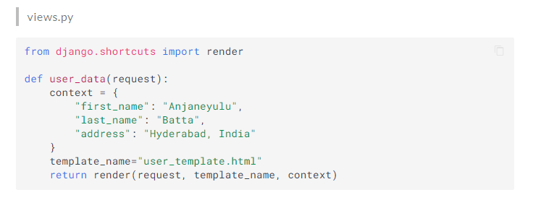
Sending data from view to template

Slide 52
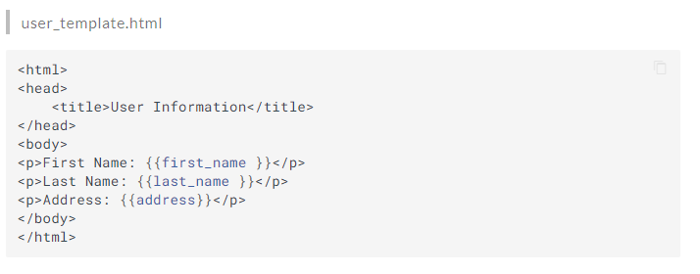
Sending data from view to template

Slide 53
Sending data from view to template
“Render" is the most used function in django. It combines a given template with a given context dictionary and returns an HttpResponse object with that rendered text.
It takes three arguments "request", "template_name" and "context" dictionary.
In template we can access the context dict keys as names**or variables** and display them like "{{ <variable/name>}}".
Django provides a template tag "for" to provide the for loop functionality in django templates. You can find the “for loop” syntax below.
{% for local_name in iterable_name %}
{{ local_name }}
{% endfor %}

Slide 54
Saving objects into database
//ONE LINE SYNTAX TO SAVE DATA
person = Person.objects.create(first_name="John", last_name="Deo")
//YOU CAN ALSO USE BELOW CODE TO SAVE DATA
person = Person(first_name="John", last_name="Deo")
person.save()
Creating or saving object data in Django is very simple and it can be achieved using the provided code snippet. In the code snippet, we are using a 'Person' model which has fields named 'first_name' and 'last_name'. The above code will insert data into the table where 'John' will be inserted in the 'first_name' column and 'Deo' will be inserted into the 'last_name' column.

Slide 55
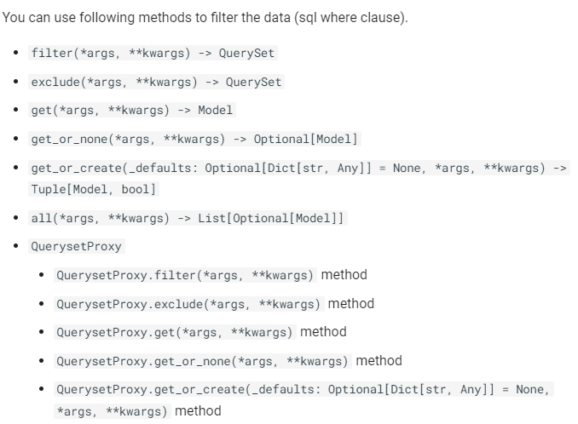
Sorting objects, Filtering objects, Deleting objects

Slide 56
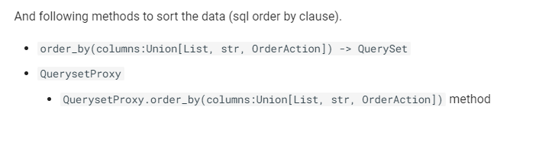
Sorting objects, Filtering objects, Deleting objects

Slide 57
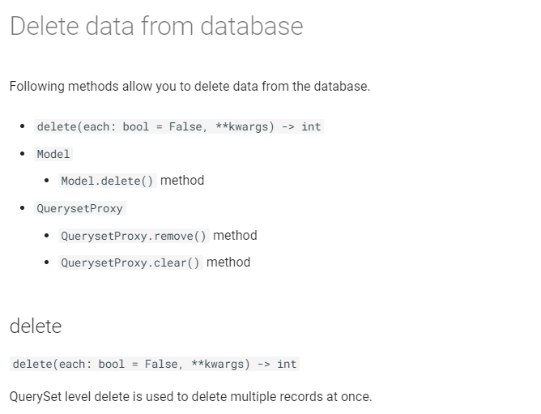
Sorting objects, Filtering objects, Deleting objects

Slide 58
Session and Cookie
Cookies, technically called HTTP Cookies are small text files which are created and maintained by your browser on the particular request of Web-Server. They are stored locally by your browser, and most browser will also show you the cookies generated in the Privacy and Security settings of the browser.
HTTP is a stateless protocol. When any request is sent to the server, over this protocol, the server cannot distinguish whether the user is new or has visited the site previously.
Suppose, you are logging in any website, that website will respond the browser with some cookies which will have some unique identification of user generated by the server and some more details according to the context of the website.
Cookies made these implementations possible with ease which were previously not possible over HTTP implementation.

Slide 59
Session and Cookie
How do Cookies work?
Cookies work like other HTTP requests over the Internet. In a typical web-system, the browser makes a request to the server. The server then sends the response along with some cookies, which may contain some login information or some other data.
When the browser makes a new request, the cookie generated previously is also transmitted to the server. This process is repeated every time a new request is made by the browser.
The browser repeats the process until the cookie expires or the session is closed and the cookie is deleted by the browser itself.
Then, the cookie applies in all sorts of tasks, like when your login to a website or when shopping online on the web. Google AdSense and Google Analytics can also track you using the cookies they generate. Different websites use cookies differently according to their needs.

Slide 60
Session and Cookie
What are Sessions?
After observing these problems of cookies, the web-developers came with a new and more secure concept, Sessions.
The session is a semi-permanent and two-way communication between the server and the browser.
Let’s understand this technical definition in detail. Here semi means that session will exist until the user logs out or closes the browser. The two-way communication means that every time the browser/client makes a request, the server receives the request and cookies containing specific parameters and a unique Session ID which the server generates to identify the user. The Session ID doesn’t change for a particular session, but the website generates it every time a new session starts.
Generally, Important Session Cookies containing these Session IDs deletes when the session ends. But, this won’t have any effect on the cookies which have fix expire time.
Making and generating sessions securely can be a hefty task, and now we will look at Django’s implementation of the same.

Slide 61
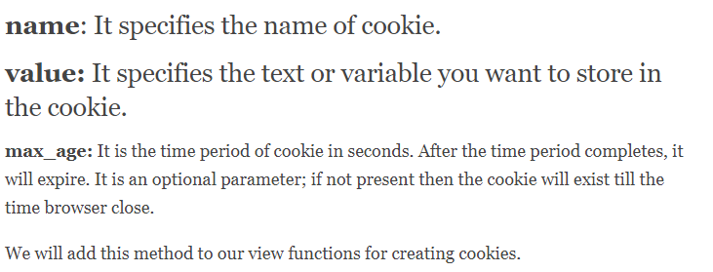
Creating sessions and cookies in Django.
Creating Cookies in Django
Django bypasses lots of work which otherwise would be required when working on cookies. Django has methods like set_cookie() which we can use to create cookies very easily.
The set_cookie() has these attributes:

Slide 62
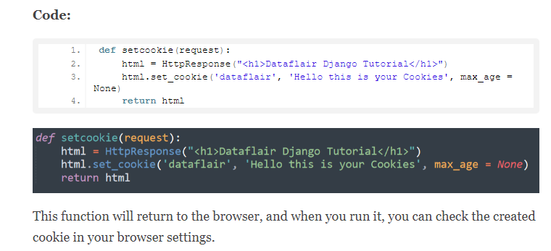
Creating sessions and cookies in Django

Slide 63
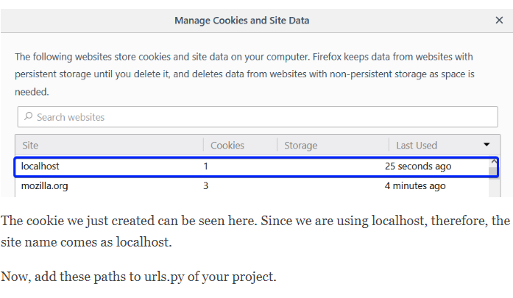
Creating sessions and cookies in Django

Slide 64
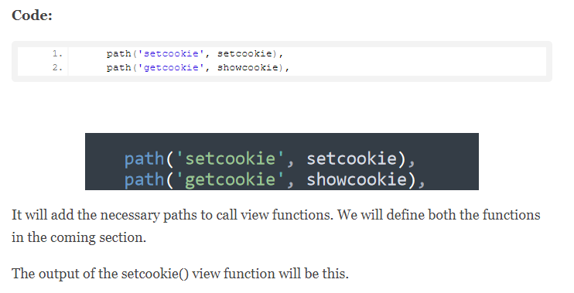
Creating sessions and cookies in Django

Slide 65
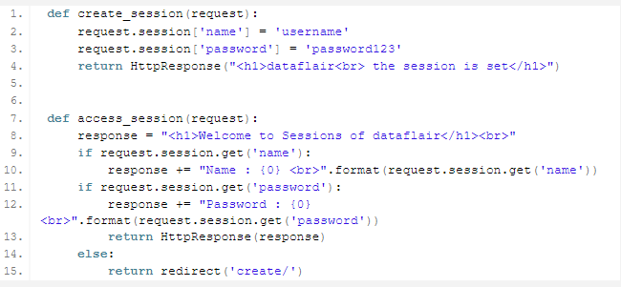
Creating sessions and cookies in Django
Creating & Accessing Django Sessions
Django allows you to easily create session variables and manipulate them accordingly.
The request object in Django has a session attribute, which creates, access and edits the session variables. This attribute acts like a dictionary, i.e., you can define the session names as keys and their value as values.
Step 1. We will start by editing our views.py file. Add this section of code.

Slide 66
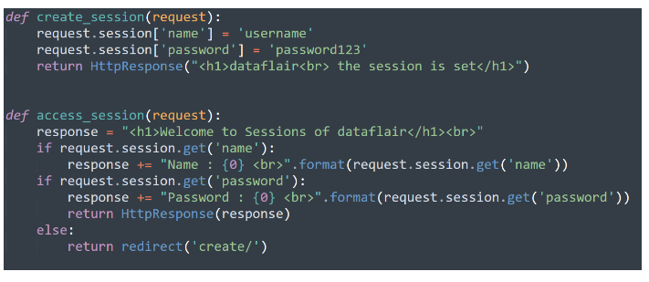
Creating sessions and cookies in Django

Slide 67
Daily Quiz
Discuss database migration.
What is the role of frameworks in python.
Discuss any three frameworks.
Discuss about concept and process of database migration.
Discuss implementation rule session and cookies in django.
Discuss the session and cookies.
Discuss how to save a object in data base .
Discuss the application area of django.
Discuss about the Request Http methods in Python.
Discuss about http application.

Slide 68
Weekly Assignment
What are the most important uses of Django.
What are the disadvantages of Django?
What are the different data types used in Django.
What are the salient features of Django session and cookies.
What are some of the technical features that Django includes

Slide 69
Topic Link ( YouTube & NPTEL Video Links)
YouTube /other Video Links
https://youtu.be/eoPsX7MKfe8?list=PLIdgECt554OVFKXRpo_kuI0XpUQKk0ycO
https://youtu.be/tA42nHmmEKw?list=PLh2mXjKcTPSACrQxPM2_1Ojus5HX88ht7
https://youtu.be/8ndsDXohLMQ?list=PLDsnL5pk7-N_9oy2RN4A65Z-PEnvtc7rf
https://youtu.be/QXeEoD0pB3E?list=PLsyeobzWxl7poL9JTVyndKe62ieoN-MZ3
https://youtu.be/9MmC_uGjBsM?list=PL3pGy4HtqwD02GVgM96-V0sq4_DSinqvf

Slide 70
MCQ s
1. What is a Django App? ADjango app is an extended package with base package is Django B. Django app is a python package with its own components. C. Both 1 & 2 Option D. All of the above | 2. Django was introduced by A. Adrian Holovaty B. Bill Gates C. Rasmus Lerdorf D. Tim Berners-Lee
3. What are Migrations in Django A. They are files saved in migrations directory. B. They are created when you run make migrations command. C. Migrations are files where Django stores changes to your models. D. All of the above
4. Which architectural pattern does django follow APHP B. MVT C. HTML D. None of the above

Slide 71
MCQ s
which of these is not a valid backend for caching in django
A. Django.core.cache.backends.sys.memory
B. django.core.cache.backends.db.DatabaseCache
C. django.core.cache.backends.locmem.LocMemCache
D. None of the above
5. Which architectural pattern does django follow
A.PHP
B. MVT
C. HTML
D. None of the above

Slide 72
MCQ s
6. Python is a : Development environment Set of editing tools Programming Language | Python is Case Sensitive when dealing with Identifiers? Yes No Sometimes Only None Of the Above
What is the OUTPUT of the following Statement? print 0xA + 0xB + 0xC : 0xA0xB0xC 33 ABC 000XXXABC | What is the OUTPUT when the following Statement is executed? “abc”+”xyz” abc abcxyz abcz abcxy
what is the type of a? a={1,2:3} list set dict syntax error

Slide 73
Glossary Questions
Top 10 design pattern interview questions
Explain Django Architecture?
Explain the Django project directory structure?
What are models in Django?
What are templates in Django or Django template language?
What are views in Django?
What is Django ORM?
What is Django Rest Framework(DRF)?
What is the difference between a project and an app in Django?
What are different model inheritance styles in the Django?
What are Django Signals?

Slide 74
Expected Questions for University Exam
Top 10 design pattern interview questions
Explain Django Architecture?
Explain the Django project directory structure?
What are models in Django?
What are templates in Django or Django template language?
What are views in Django?
What is Django ORM?
What is Django Rest Framework(DRF)?
What is the difference between a project and an app in Django?
What are different model inheritance styles in the Django?
What are Django Signals?

Slide 75
Summary
Till Now we understand The idea of Database migration is the process of migrating data from one or more source databases to one or more target databases by using a database migration service. When a migration is finished, the dataset in the source databases resides fully, though possibly restructured, in the target databases. In django, we retrieve the data in the views.py file, where we write our functions. To retrieve data from database, first we have to create a url for that. Open the urls.py file inside the application folder. Cookies work like other HTTP requests over the Internet. In a typical web-system, the browser makes a request to the server. The server then sends the response along with some cookies. After observing these problems of cookies, the web-developers came with a new and more secure concept, Sessions.
The session is a semi-permanent and two-way communication between the server and the browser.

Slide 76
References
(1) Tom Aratyn, “Building Django 2.0 Web Applications: Create enterprise-grade, scalable Python web applications easily with Django 2.0”, 2nd Edition 2018, Packt Publishing.
(2) Nigel George, “Build a website with Django”, 1st Edition 2019, GNW Independent Publishing Edition.
(3) Ray Yao,” Django in 8 Hours: For Beginners, Learn Coding Fast!, 2nd Edition 2020, Independently published Edition.
(4) Harry Percival, “Test-Driven Development with Python: Obey the Testing Goat: Using Django, Selenium, and JavaScript”, 2nd Edition 2019, Kindle Edition.

Slide 77
THANK YOU

